Slide 1

Model View present
Anthony Lim, December 2017

Slide 2
Contents
Why I learnt MVP?
Why use MVP?
Disclaimer
General Comments about MVP
View
Presenter
Model
Muon Analysis v2 (so far)
MVP in complex GUI’s

Slide 3
Why I learnt MVP
MVP (model-view-presenter) is a pattern for writing GUIs
The Muon group wanted a new GUI
The benefits of MVP were worth the effort to learn about it

Slide 4
Why use MVP
It is a modular design
Can use automated testing
Tests can be streamlined via mocking (no need to run model when testing presenter)
However, it is difficult to implement without carful planning

Slide 5
Disclaimer
I am not an expert on MVP
MVP is a pattern, there are no hard or fast rules. So its open to interpretation
This is my understanding of MVP

Slide 6
General comments
Each part of the MVP has its own unique role
View is the look of the GUI
Model is the heavy lifting
Presenter is the go between for the model and view
Model and View never communicate directly
View is the only part with significant amounts of Qt (presenter may have connections)
In theory should be able to replace a view or model with minimal changes

Slide 7
Demo

Slide 8
View
View is the look of the GUI
Can use a QtCreator to create the appearance
Should be simple – no logic or complex operations

Slide 9
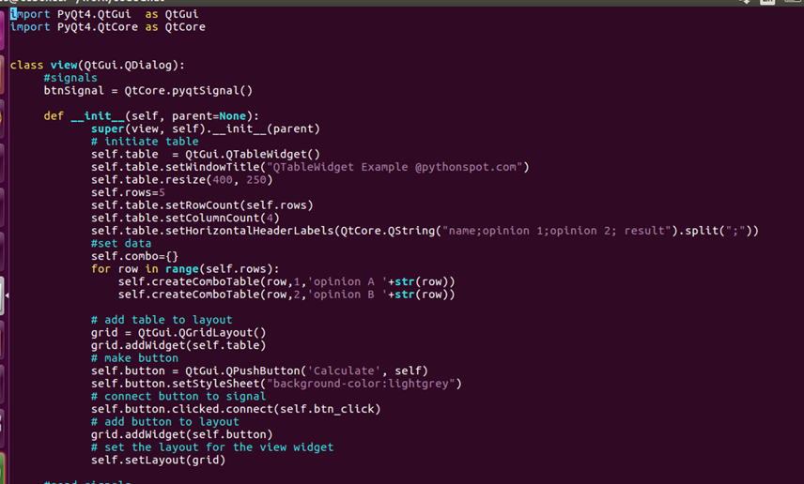
View
Custom signal
Add a parent to the view
Creates the widgets in view (can use QtCreator instead)
Connect widget to a function

Slide 10
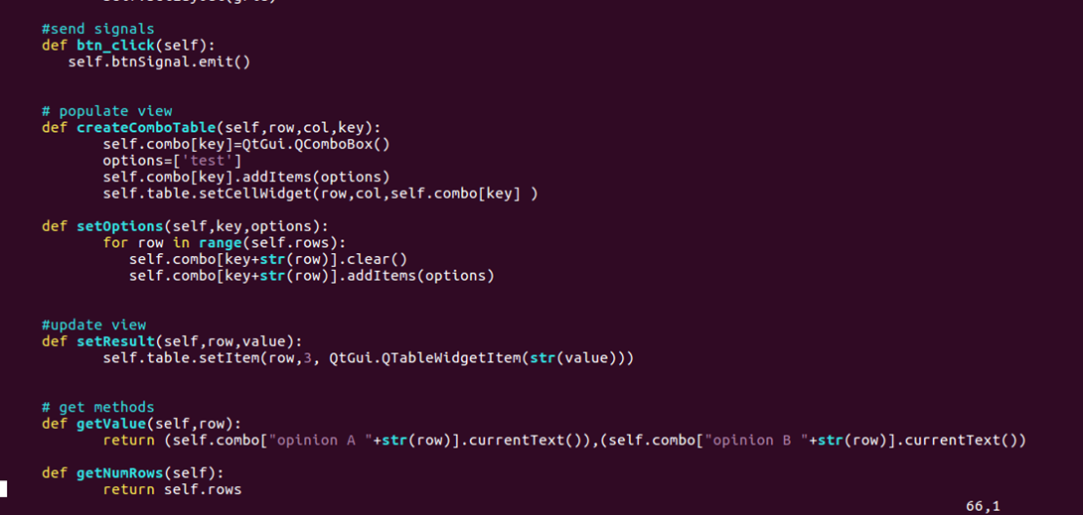
View
Emit custom signal
Helps create widget
Update look of View
Get values from View

Slide 11
View
Should contain the following things:
Set parent
Load/create widgets for interface
Connect from in-built signals to custom signals
Set methods (update the view)
Get methods (extract values from view)

Slide 12
Presenter
It’s the go between for the model and view
Only Qt it may contain is connect statements (can alternatively use notify)
All received signals should call a function (slot) in the presenter
Should not contain any hard sums
The model and view should be passed into the presenter

Slide 13
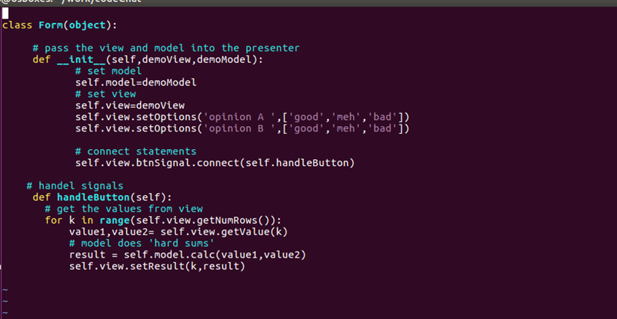
Presenter
Pass in view and model
Update view
Connect custom signal
Get information from view
Send information to model and get result
Update view with model result

Slide 14
Presenter
Presenter should contain:
Set view and model
Connect/notify
Handle event slots
Helpers (if needed)
The custom signals, get and set methods for the view allow for the view to be swapped out (if the same functions exist)

Slide 15
Model
The model does the hard work
A presenter may have multiple models
A Mantid algorithm is a ‘model’ – for testing it is worth putting it into a model class that can be mocked

Slide 16
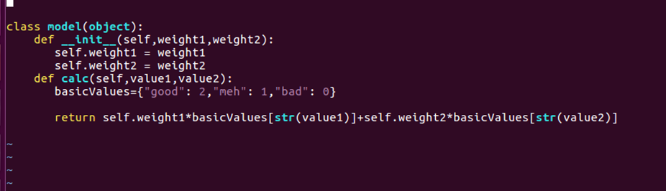
Model

Slide 17
Model
This was a trivial example
A model will somehow receive values from the presenter
The model will somehow return the values to the presenter

Slide 18
Muon Analysis v2
Spent a couple of weeks planning the GUI
Each self contained widget will be MVP
Models and presenters will have tests
The tabs can be ejected from the main window

Slide 19
Muon Analysis v2
Demo

Slide 20
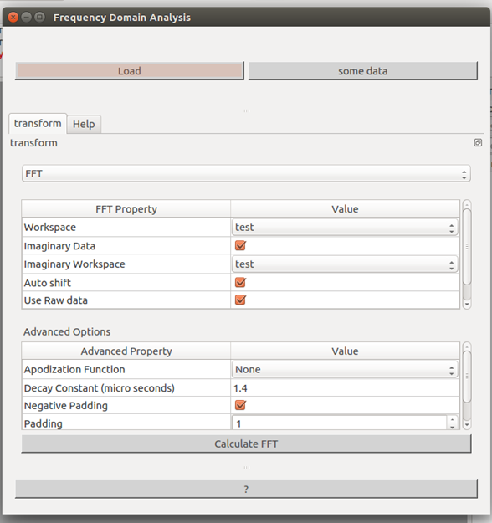

MVP in complex GUI’s
Widget 1
Widget 2
Widget 3

Slide 21
MVP in complex GUI’s
Each tab is its own widget (with its own MVP)
The view just adds the individual widgets into the tab widget and overrides closeEvent method
The presenter creates the presenters for the individual widgets

Slide 22
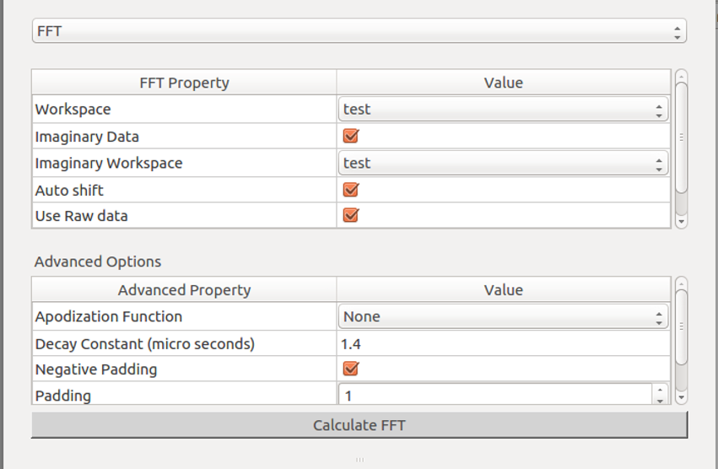
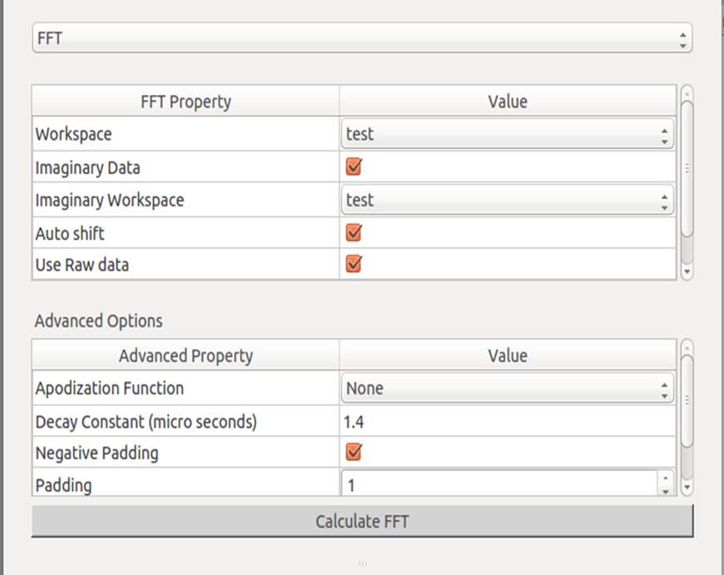
MVP in complex GUI’s
Widget 1
Widget 2

Slide 23
MVP in complex GUI’s
Widget 1 determines the display in widget 2
Widget 2 has two different flavours (2a and 2b)
The view contains a layout of the three widgets (hide either 2a or 2b)
View has methods to hide both widgets and to show a specific widget

Slide 24
MVP in complex GUI’s
The presenter connects to a signal from the view of widget 1 – to update the selection for widget 2
Sets the presenters for the 3 widgets

